Slide 1
Developing Dataspaces
Technical and Regulatory Basics
Moritz Eckert, Martin Lanz, Clemens Danda Institute for AI-Safety and Security, 03.12.2024
Notes:
Welcome to our presentation Developing Dataspaces, Technical and Regulatory Basics.
My name is Martin Lanz and I am working for about one year in the DLR in the Institute for AI-Safety and Security. I will start with the technical introduction and my colleagues will then follow up with more in depth technical and also regulatory details.

Slide 2
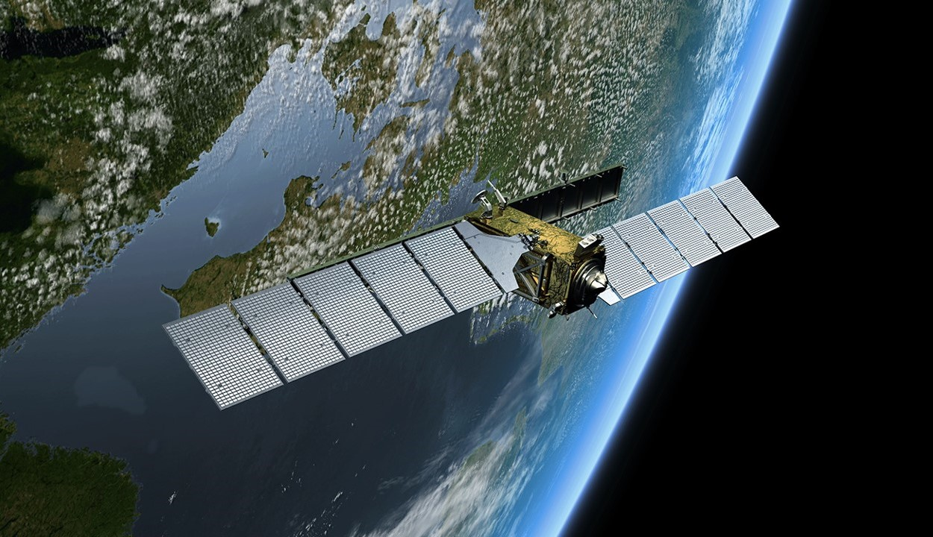
Technical basics
Moritz Eckert, Martin Lanz, Clemens Danda Institute for AI-Safety and Security, 03.12.2024
Notes:
Lets dive into the technical basics ….

Slide 3
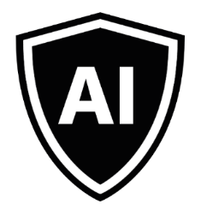
Definition
A dataspace is a federated infrastructure enabling secure, controlled data sharing among participants based on common policies and standards, ensuring data sovereignty, including control over who can access the data and under what conditions.
Notes:
… starting with a short definition about what a Dataspace is.
Im Prinzip kann man sagen das ein Datenraum eine dezentrale cloudinfrastruktur ist, die es Nutzern ermöglicht Daten unter festgelegten Bedingungen zu tauschen bei dem der Verhandlungsprozess komplett automatisch vollzogen wird.
Generally it can be said that a dataspace is a cloud infrastructure which allows users to share data or services in a decentralized fashion under set conditions where the negotiation process is handled fully autonomous.

Slide 4
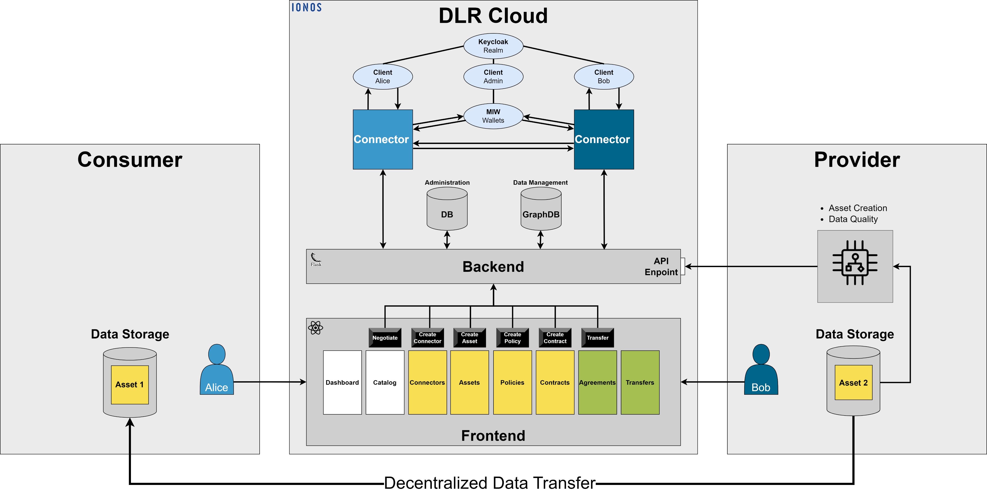
Overview
Notes:
Here you can see an abstraction of the architecture we have been working on. It might seem complicated but we will discuss each of the components you can see on this diagram. Breaking it down we going to focus about the dataspace ….

Slide 5
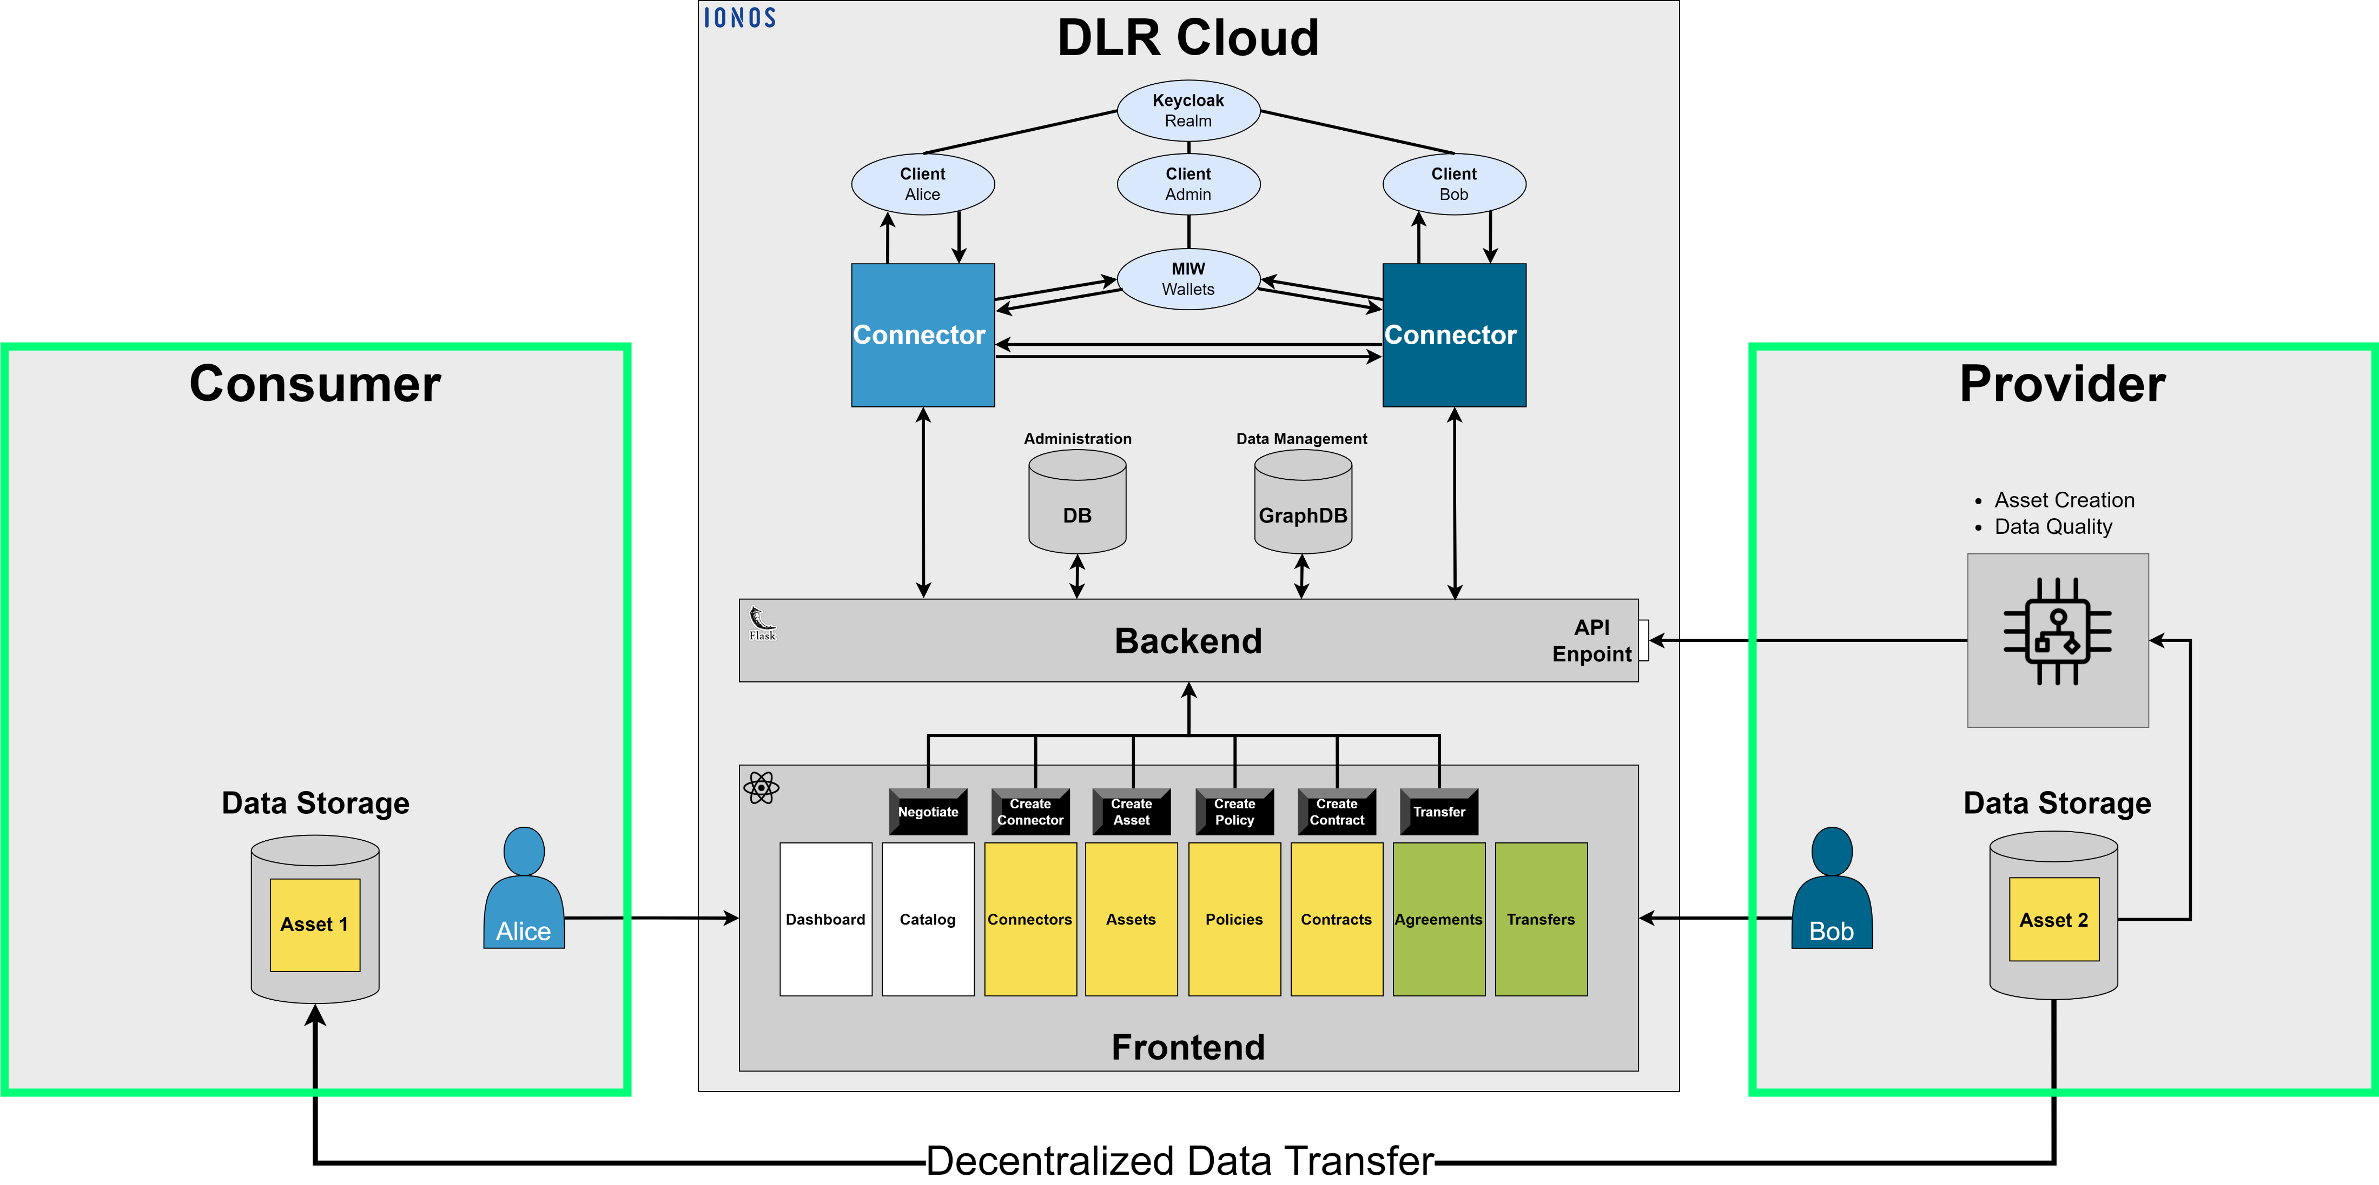
Participants
Notes:
… participants here as consumer and provider with names Alice and Bob …

Slide 6
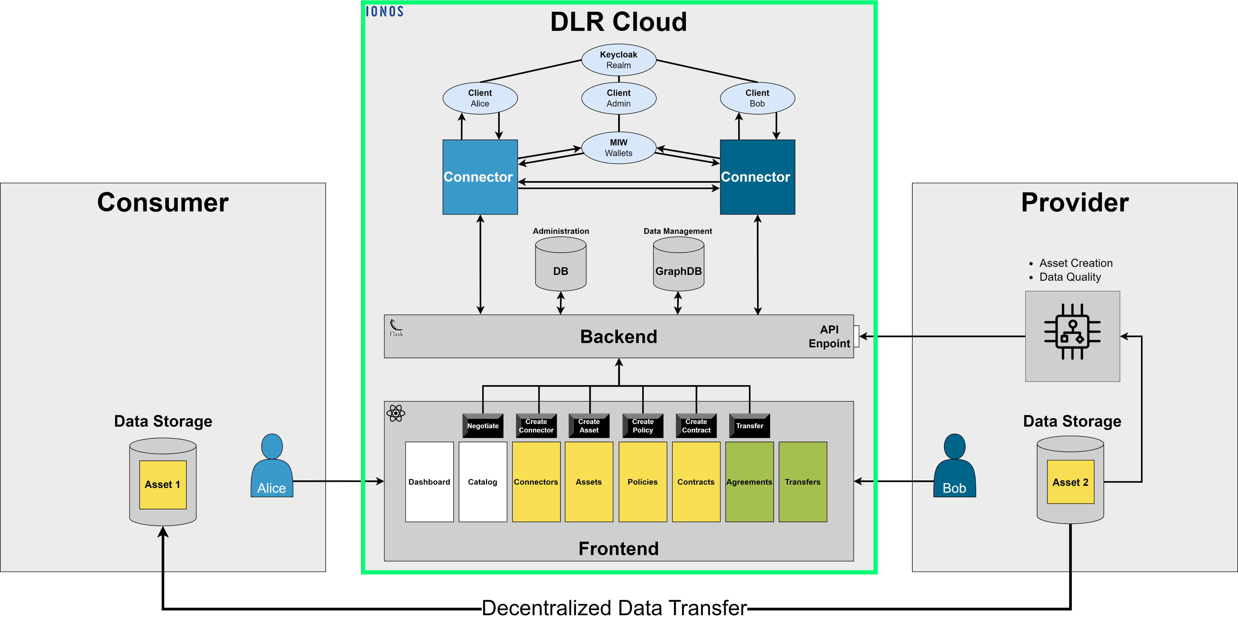
Infrastructure
Notes:
… the infrastrucutre itself which is divided again in three individual components …

Slide 7
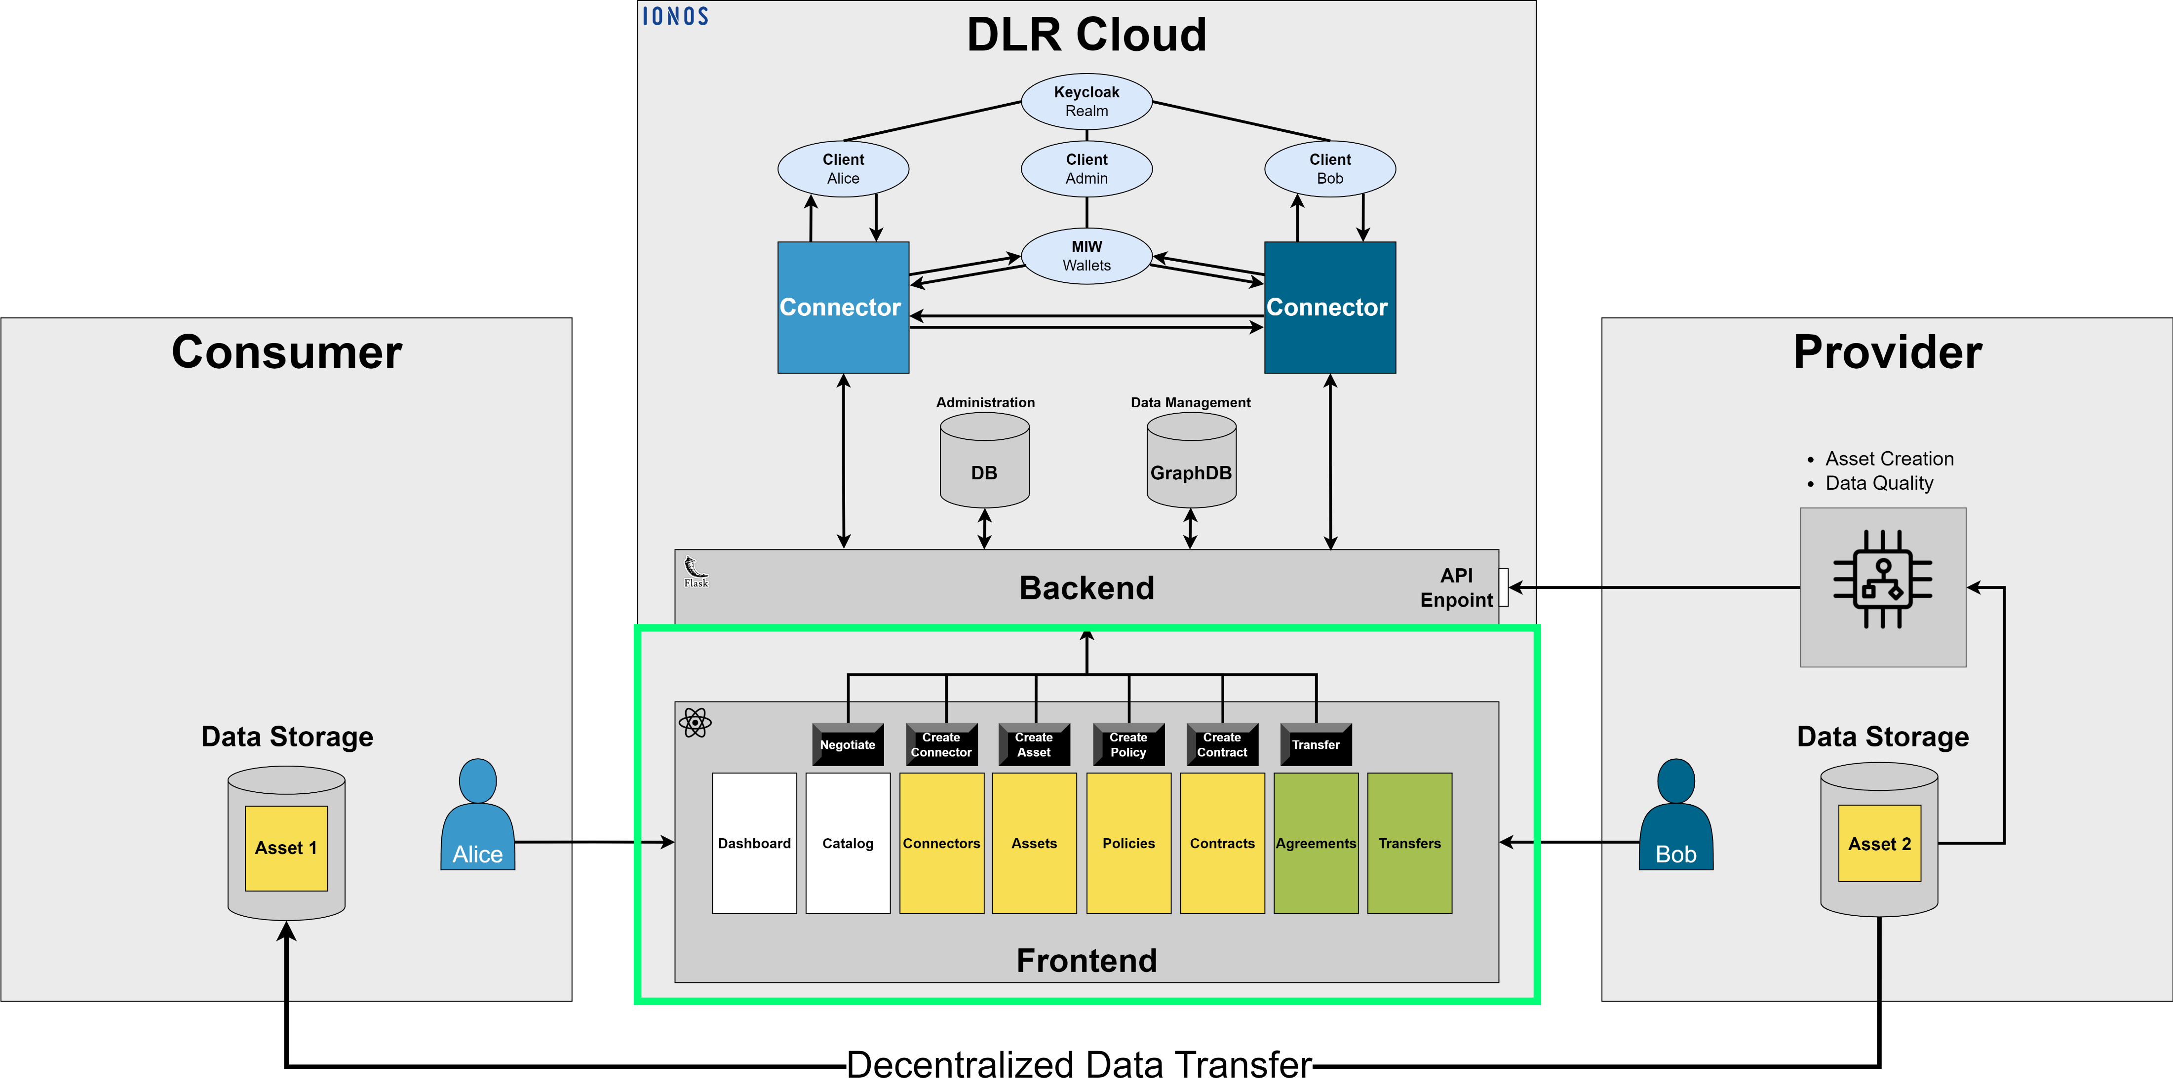
React Frontend
Notes:
… a react web application as the frontend …

Slide 8
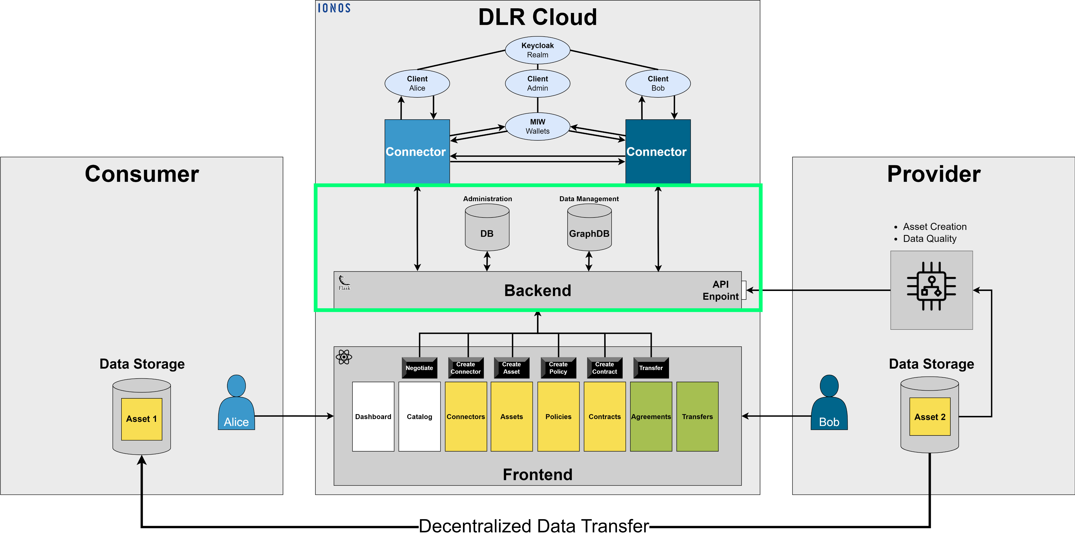
Flask Backend
Notes:
.. the backend …

Slide 9
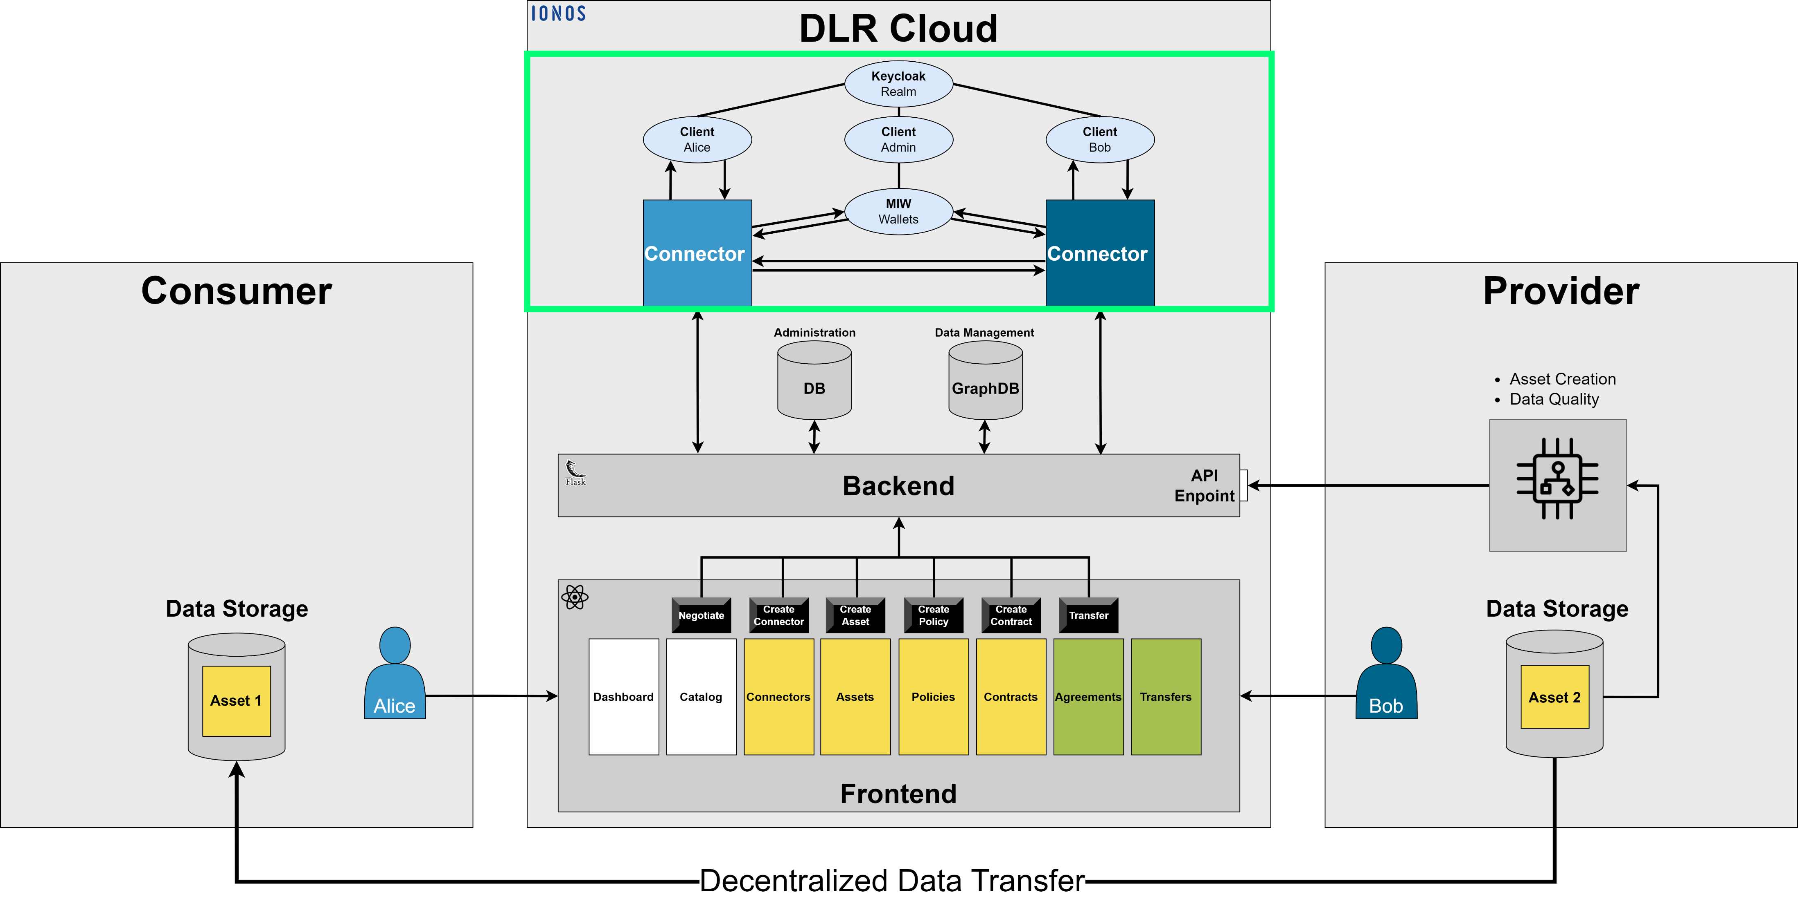
Connector Technology
Notes:
… and the connector technology

Slide 10
Overview

Slide 11
Participants
Notes:
Starting with the Dataspace participants we can see a consumer participant Alice and a Provider participant Bob, which we will use throughout this example. Of course the Dataspace is not limited to just two users, in theory we can have as many users as our infrastructures resources can handle. What is important to understand here is that the Data Storages are located at the users facilities and sharing will always be handled in a decentralized fashion which is indicated by the arrow which goes from Provider to Consumer, circumventing the infrastructure box in the middle.

Slide 12
Overview
Notes:
So that opens the question, why do we need all this infrastructure if Bob could simply send its data directly to Alice. So lets dive a bit deeper into what the infrastructure does and how it can be used if Bob, as the provider wants to share some data with Alice as the consumer.

Slide 13
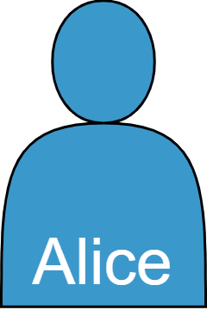
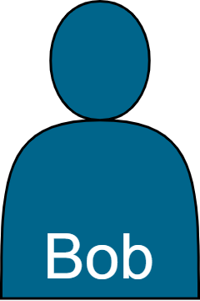
Overview
Notes:
Here you can see our frontend and the two participants Bob and Alice. This is where the participants can interact with the dataspace using its core functionalities.

Slide 14
Overview
Notes:
Starting from left to right we have a Dashboard which provides an overview of the dataspace with metrics, diagrams and further important information. (Note this is still under development so currently the tab is empty).

Slide 15
Overview
Notes:
As the second tab we have a catalog where users can see other participants offers.
You can think of the catalog as a marketplace where all assets of every user in the dataspace are present. You can see that the catalog has as negotiation button, which is a functionality to agree to an offer provided by another user.

Slide 16
Overview
Notes:
Then we have the connector tab where users can create or modify connectors. My colleague will explain in a minute in more detail about what a connector is and what it is used for.

Slide 17
Overview
Notes:
Then we have the assets, policies and contracts tabs where users can define their assets and determine under what conditions a transfer could take place.

Slide 18
Overview
Notes:
And lastly we have the agreements and transfers tabs which simply list a history of past agreements and transfers made.

Slide 19
Overview
Notes:
So what does Bob have to do now if he has data and wants to offer it to Alice? To keep this briefly, Bob just needs to login to the website, go to the …

Slide 20
Overview
Notes:
… assets tab and click the …

Slide 21
Overview
Notes:
… create asset button and add some information like the name of the data and some further details. He can then link this asset with a …

Slide 22
Overview
Notes:
… policy to formulate a …

Slide 23
Overview
Notes:
… contract which will then automatically create an offer for this data within the …

Slide 24
Overview
Notes:
… catalog. Note that when creating an Asset, Bob is just registering the metadata of the asset and not the asset itself. The real asset always stays at the users local storage.
Alice could now view this offer and click …

Slide 25
Overview
Notes:
… negotiate and the offer would then be displayed in the …

Slide 26
Overview
Notes:
… agreements tab from where it could be transferred to her if she clicks the …

Slide 27
Overview
Notes:
… transfer button.

Slide 28
Overview
Notes:
To have all this functionality implemented, a frontend is not enough. So my colleague Moritz Eckert will provide a more detailed view on the backend and connector technology and also explain what exactly happens if Alice clicks on the …

Slide 29
Overview
Notes:
… transfer button.

Slide 30
Overview

Slide 31
Overview

Slide 32
Overview

Slide 33
Overview

Slide 34
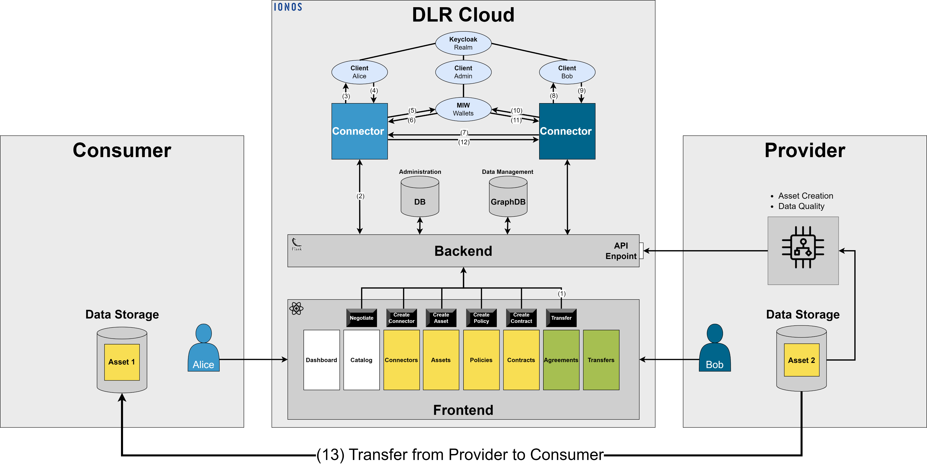
Overview

Slide 35

Overview

Slide 36

Overview

Slide 37
Overview

Slide 38
Use Cases
Moritz Eckert, Martin Lanz, Clemens Danda Institute for AI-Safety and Security, 03.12.2024

Slide 39
DEmo
Moritz Eckert, Martin Lanz, Clemens Danda Institute for AI-Safety and Security, 03.12.2024

